Slide 1
West Nile Virus Prediction Analysis
in Chicago
Matthew | Esther | Zhi Cong

Slide 2
Agenda
Background
Background information
Project objective
Data analysis
Overview of datasets
Exploratory Data Analysis
Modelling
Feature Engineering
Model selection & tuning
Conclusion
Model insights
Cost-Benefit Analysis & Recommendations

Slide 3
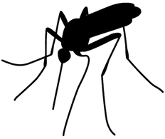
Understanding the problem
West Nile Virus
Chicago
Spread to humans through infected mosquitos.
Symptoms:
persistent fever
serious neurological illnesses
death
2002: First human case reported
2004: Established surveillance & control program
Testing results influence location and timing of airborne pesticide sprays
Notes:
West Nile virus is most commonly spread to humans through infected mosquitos. Around 20% of people who become infected with the virus develop symptoms ranging from a persistent fever, to serious neurological illnesses that can result in death.
In 2002, the first human cases of West Nile virus were reported in Chicago. By 2004 the City of Chicago and the Chicago Department of Public Health (CDPH) had established a comprehensive surveillance and control program that is still in effect today.
Every week from late spring through the fall, mosquitos in traps across the city are tested for the virus. The results of these tests influence when and where the city will spray airborne pesticides to control adult mosquito populations.

Slide 4
Project objective:
To predict the probability of the presence of West Nile Virus
For a specific location
On a specific date

Slide 5
Logistic Regression
Support Vector Machine classification
K Nearest Neighbour
Random Forest
Decision Tree / Extra Trees
Boosting (Ada, Gradient, XG)
Analysis of interaction of WNV presence with original features
Comparison and selection of model based on desired metric
Data Cleaning/ Feature engineering
Model selection
Prelim EDA
Generating models
Fine tuning
Preprocessing
Feature engineering
Train-Test-Split
Model preparation
Accounting for imbalanced data
Hyperparameter tuning of models
Data Modeling Workflow

Slide 6
Data Analysis

Slide 7
Datasets
Train
Weather
Spray
Trap records:
2007, 2009, 2011, 2013
Location
Date
Number of mosquitos
Presence of WNV
Weather locations:
2007 -2014
2 weather stations
O’Hare airport
Midway airport
Spraying efforts:
2011 and 2013
2 spray date in 2011
8 spray dates in 2013
Date
Location
*Missing values and duplicates were dropped for spray dataset

Slide 8
Data Analysis:
Train dataset

Slide 9
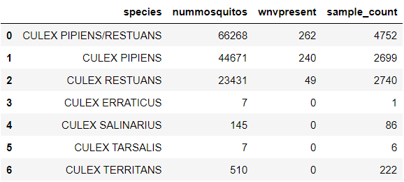
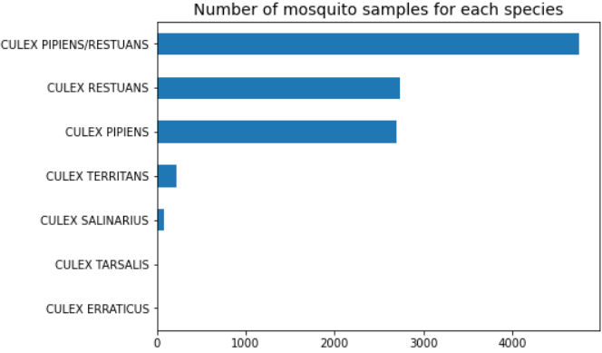
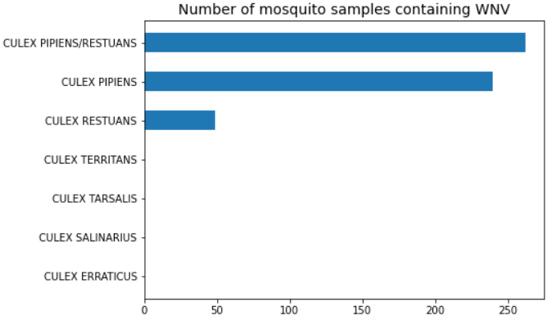
Different mosquito species
Datasets
2 most common species: Culex Pipiens and Culex Restuans
Also the only 2 species that carry WNV
Much more Culex Pipien samples that are WNV-present
Highest proportion of WNV-present samples: Culex Pipiens could be the more dangerous species
Notes:
The above table shows the number of sample counts for each species of mosquito, as well as how many of these samples contain WNV. We can immediately tell that the 2 most common species of mosquitoes are the Culex Pipiens and Culex Restuans, and samples containing both these species are the most common in Chicago. They are also the only 2 species that carry WNV.
The table also shows us that, the total number of Culex Pipiens is almost 2 times more than the Culex Restuans. However, they have lesser sample counts, which may suggest that the population of Culex Pipiens is higher in each sample/cluster. There were much more Culex Pipiens samples that are WNV-present.
Overall, Culex Pipiens could be considered the more dangerous species due to having the highest proportion of WNV-present samples.

Slide 10
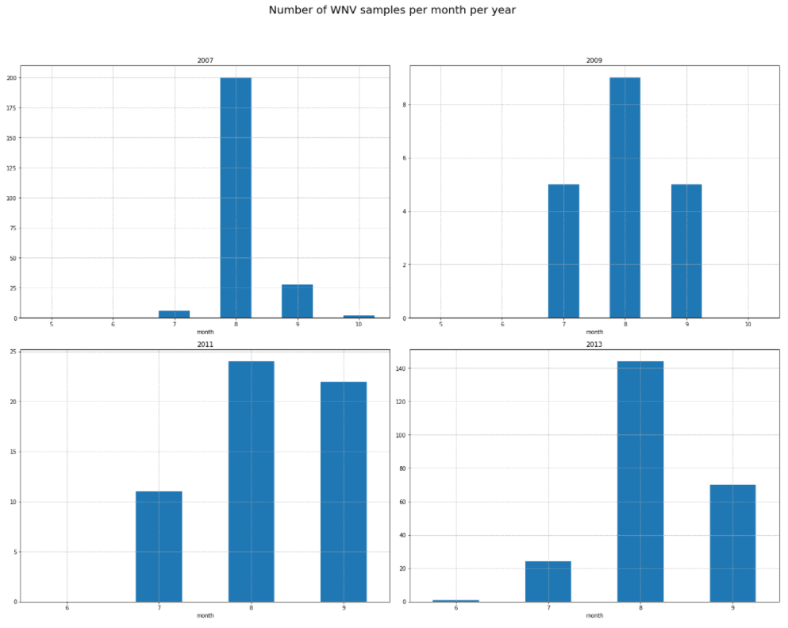
Number of WNV cases per month for each year
Datasets
Year with highest WNV: 2013
WNV starts around June, rise rapidly from July
Peak month: August
Reduce from Sept, cease from Oct
Summer months in Chicago: June to August
Notes:
The year with the highest WNV occurrences is 2013, followed by 2007. It is generally quite low in the years 2009 and 2011.
A pattern can also be observed here. WNV occurrences start at around June, and rise rapidly from July onwards. August is the peak month with the most WNV occurence for all years. Thereafter, the occurrences start to reduce through September and cease from October.
June to August are the summer months in Chicago, when it is the hottest in the year. Our first guess would be that the temperature during the summer season exacerbated the breeding of mosquitoes and which in turn increase the number of WNV occurrences.

Slide 11
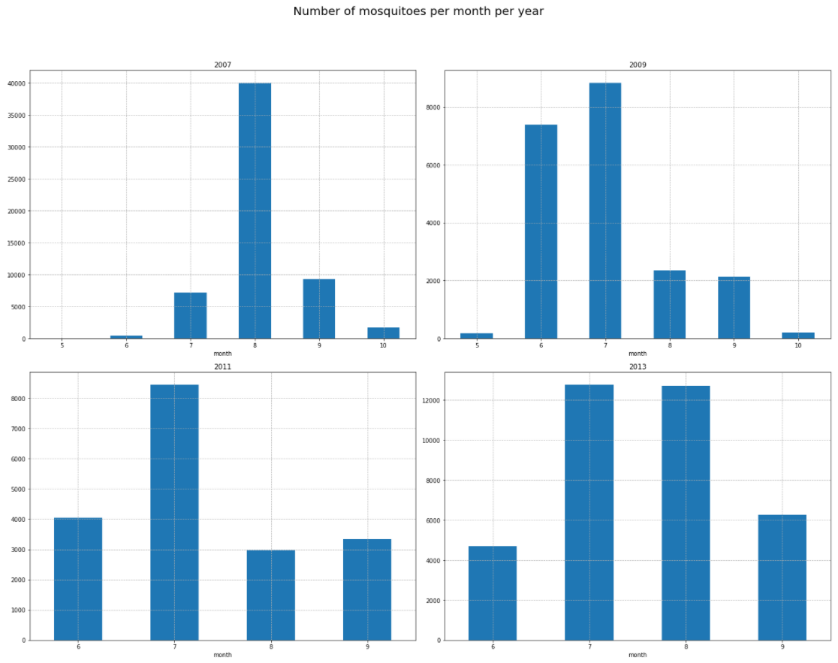
Number of mosquitoes trapped per month for each year
Datasets
Month with highest number of mosquitoes: July or August
Highest number of mosquitoes precede highest number of WNV occurrences
Notes:
High number of mosquitoes precede high number of WNV occurrences. We will explore more of this in the upcoming slides

Slide 12
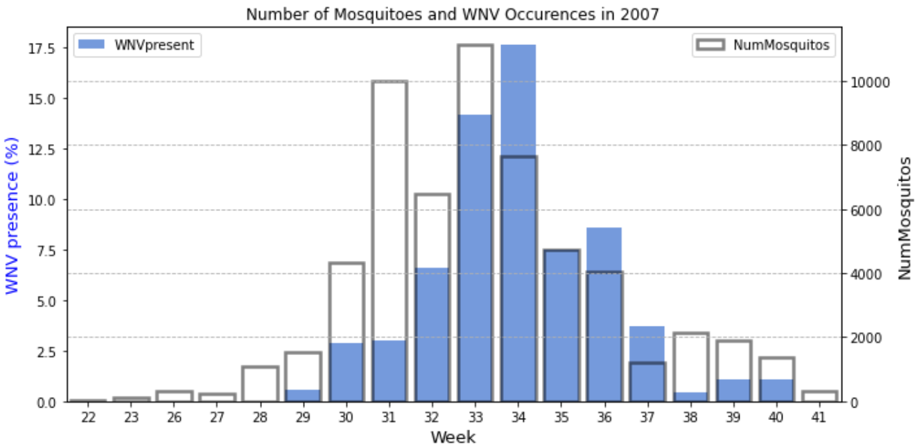
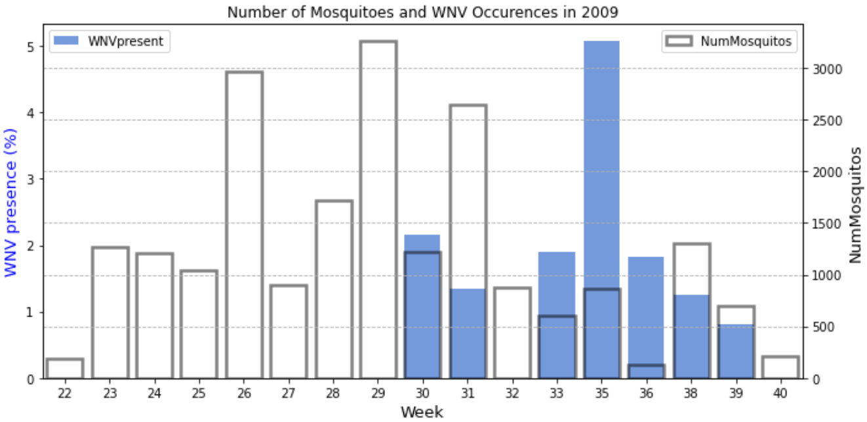
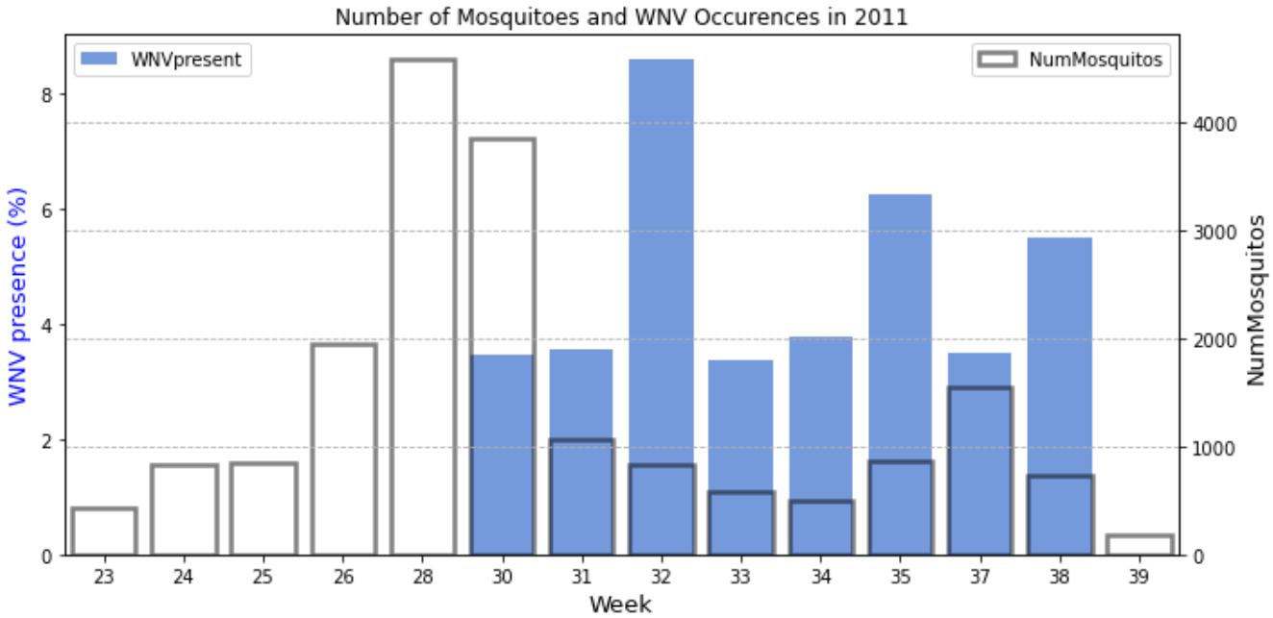
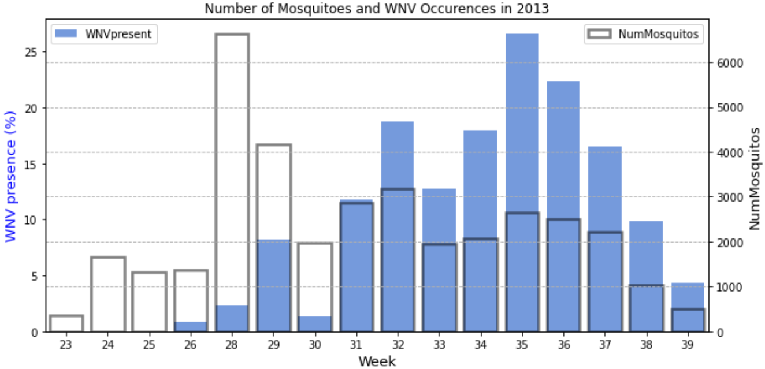
Number of WNV cases VS Number of mosquitoes
Datasets
High number of mosquitoes precede high number of WNV
High number of mosquitoes: week 26 to 33
High WNV cases: week 30 to 39
Notes:
Plotting number of WNV cases in percentage VS number of mosquitoes. The data is split in weeks instead of months for a more in-depth analysis.
It seems like high proportion of WNV cases and high number of mosquitoes do not happen together. High proportion of WNV cases happen much later, at weeks 30 to 39. Data for high number of mosquitoes is much more erratic. Depending on the year, high number of mosquitoes peak earlier as compared to WNV cases, at around week 26 to 33.

Slide 13
Data Analysis:
Weather dataset

Slide 14
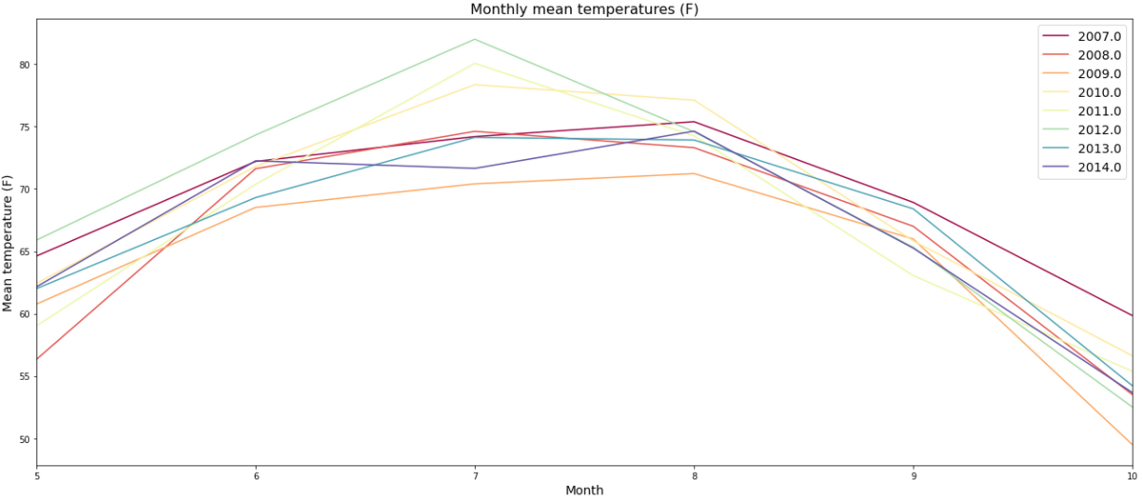
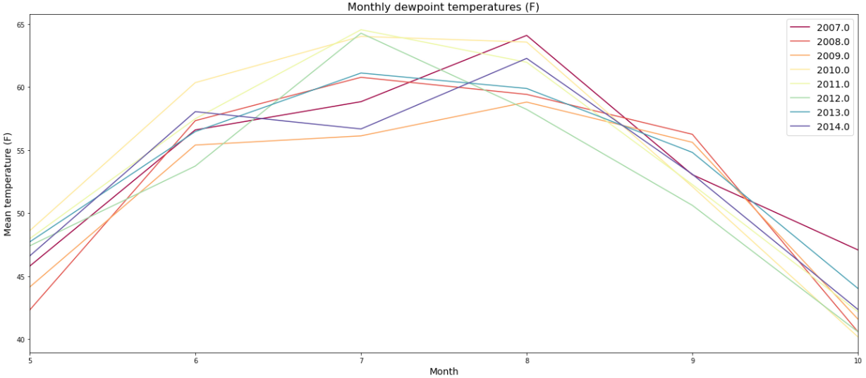
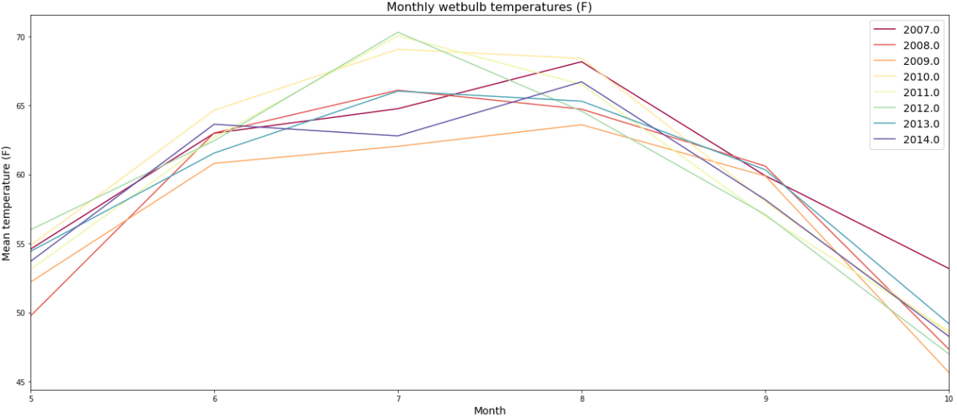
Weather Dataset:
Temperature
Monthly mean temp
Dew-point temp
Wet-bulb temp
Summer months: Similar trends with high number of mosquitoes and high WNV over the months of June, July and August
High humidity - High mosquito activity
High precipitation - High WNV
Notes:
When comparing this to the weekly average relative humidity graphs, we can see that there is a semblance of a similar trend ongoing as well. This is of no surprise as relative humidity is important to mosquito activity. In general, high humidity conditions favor mosquito activity, while low humidity suppresses activity and may even cause mortality. As such, we will also be feature engineering the weekly average relative humidity for a time lag of between 1-4 weeks.
When looking at the relationship between precipitation and WNV cases, we can see from the graph in Year 2007 that certain peak in WNV cases only occur when there is high precipitation. However, this trend is not as evident across the four years as compared to the graphs looking at the relationship between temperature and humidity. For example in the Year 2013 graph, at the week 32 peak of the WNV presence line, it seems to be from a time lag of 1 week ago where there was a peak in the weekly precipitation line at week 31. However, at the next peak in WNV presence at week 35, it is unclear if this was due to the spike in weekly precipitation in the same week (week 35) or if it was due to a smaller spike at week 33. Nonetheless, keeping this in mind, we will proceed with feature engineering this column as well as it seems like it could be a potential lead indicator in predicting the spikes in the WNV presence.

Slide 15
Data Analysis:
Combined dataset

Slide 16
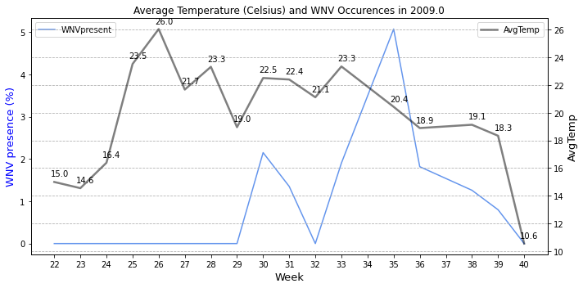
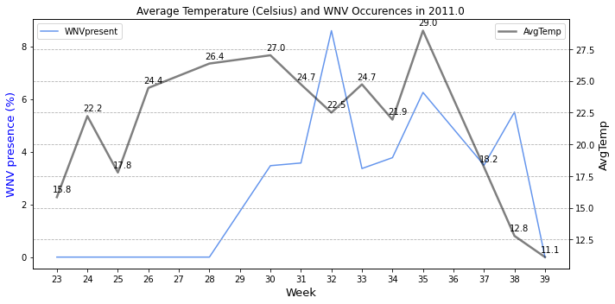
WNV
Average temperature
Time
Potential lead indicator
Lead indicator: shows change in direction before corresponding change in target
2009:
Week 28-30
Week 33-35
2011:
Week 30-32
Week 33-35
Week 35-38
Feature engineer time lag columns
Notes:
When plotting the weekly average temperature (celsius) and West Nile Virus occurences against the weeks of the individual years, we can see that the weekly average temperature can potentially be used as a lead indicator of the virus occurence. A lead indicator shows a change in direction before a corresponding change in the target variable.
Looking at the graphs above, we can see that a peak in the weekly average temperature comes just 2-3 weeks before a peak in the percentage of the presence of the virus. For example in the 2009 graph, at week 28, the temperature seems to spike to 23.3 degree celsius. 2 weeks later at week 30, we can see there there is a spike noted for the WNV presence. Similarly at week 33 of the same graph, the temperature spikes again to 23.3 degree celsius and then 2 weeks later at week 35 we can see that there is a spike in the WNV presence.
Likewise in the 2011 graph, we can see a similar trend occuring where the temperature reaches a peak of 27.0 degree celsius at week 30 and then 2 weeks later at week 32 the WNV presence spikes. This pattern occurs again at week 33 to 35 and week 35 to 38. This pattern is also seen in the 2013 graph at week 26 to 29, week 29 to 32 and lastly at week 32 to 35.
This solidifies the weekly average temperature’s position as a lead indicator for the presence of the West Nile Virus. With this in mind, when feature engineering, we will then proceed to feature engineer time lag columns for the weekly average temperature by shifting the weekly average temperatures between 1-4 weeks back. This is done in an attempt to better determine its correlation to the target variable (WNV presence).

Slide 17
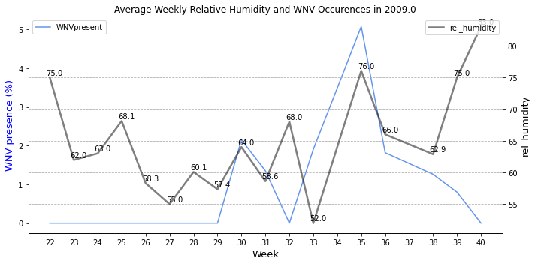
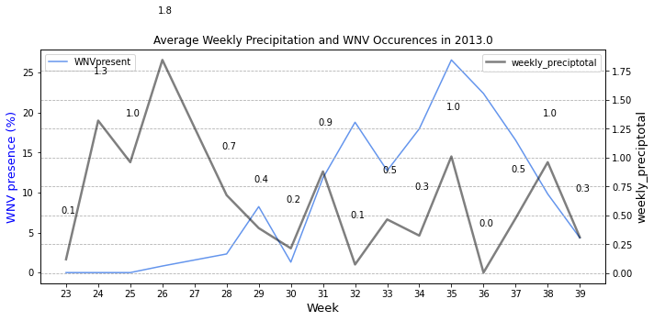
WNV
Average relative humidity/
Total precipitation
Time
Potential lead indicators as well
2009 (humidity):
Week 28-30
Week 32-35
2013 (precipitation):
Week 31-32
Week 33-35
Feature engineer time lag columns
Notes:
When comparing this to the weekly average relative humidity graphs, we can see that there is a semblance of a similar trend ongoing as well. This is of no surprise as relative humidity is important to mosquito activity. In general, high humidity conditions favor mosquito activity, while low humidity suppresses activity and may even cause mortality. As such, we will also be feature engineering the weekly average relative humidity for a time lag of between 1-4 weeks.
When looking at the relationship between precipitation and WNV cases, we can see from the graph in Year 2007 that certain peak in WNV cases only occur when there is high precipitation. However, this trend is not as evident across the four years as compared to the graphs looking at the relationship between temperature and humidity. For example in the Year 2013 graph, at the week 32 peak of the WNV presence line, it seems to be from a time lag of 1 week ago where there was a peak in the weekly precipitation line at week 31. However, at the next peak in WNV presence at week 35, it is unclear if this was due to the spike in weekly precipitation in the same week (week 35) or if it was due to a smaller spike at week 33. Nonetheless, keeping this in mind, we will proceed with feature engineering this column as well as it seems like it could be a potential lead indicator in predicting the spikes in the WNV presence.

Slide 18
Feature engineering
'species' converted to ordinal numeric
‘codesum’ converted to binary
‘tavg’ & ‘dewpoint’ to celsius
Relative humidity
Temperature
Dewpoint
Weekly average temperature and total precipitation
Time lag columns
Precipitation, avg_temp and relative humidity
Polynomial Features
Notes:
​As identified above during EDA, only 2 out of 6 mosquito species are carriers of WNV. The most dangerous specie is the Culex Pipiens, followed by the Culex Restuans.​ The percentages of WNV samples in total samples based on species was calculated where the WNV in Pipiens only was the highest at 9% followed by the Pipiens and Restuans mix with 6% and the Restuans only was 2%.
Given this, we converted the species column to ordinal numeric data, where a ranking order will be given to the species based on their percentage of WNV samples.

Slide 19
Logistic Regression
Support Vector Machine classification
K Nearest Neighbour
Random Forest
Decision Tree / Extra Trees
Boosting (Ada, Gradient, XG)
Analysis of interaction of WNV presence with original features
Comparison and selection of model based on desired metric
Data Cleaning/ Feature engineering
Model selection
Prelim EDA
Generating models
Fine tuning
Preprocessing
Feature engineering
Train-Test-Split
Model preparation
Accounting for imbalanced data
Hyperparameter tuning of models
Data Modeling Workflow

Slide 20
Data Modelling

Slide 21
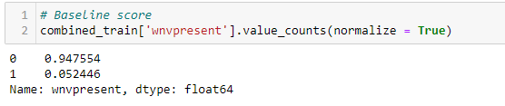
Baseline score
Models used:
Logistic Regression
K Nearest Neighbor
SVM
Decision Tree
Extra Trees
Random Forest
AdaBoost
Gradient Boost
XGBoost
Notes:
To have something to compare our model against, we can use the normalized value of y which is the percentage of y within our target.
This represents the simplest model we can use, where a random date and location given will give us a x% chance of predicting the presence of WNV. This also shows that our model is imbalanced and will have to be dealt with later on

Slide 22
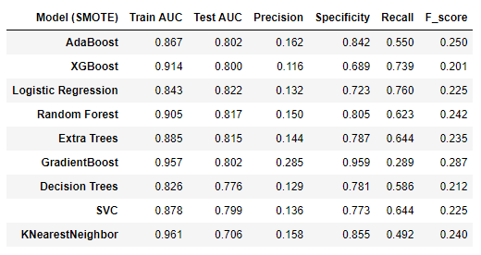
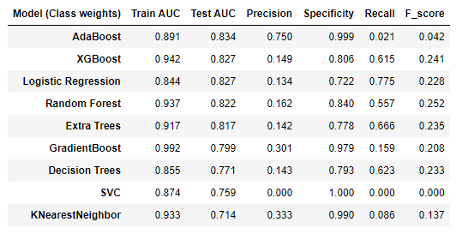
Models with SMOTE
Models w/o SMOTE
Model Evaluation
Notes:
Explain what we did for modeling
All the models that we used
Explain the different scores from different models.
The best AUC scores, and the best recall scores
Explain unsmoted logreg and why we chose it
Explain how the class-weight scored better than sampling in smote
Put in smite table with AUC score sorted
We can see that models using class weights performed slightly better in terms of test AUC than the models using SMOTE. As such, we will choose our final model from this test group. For our final model selection, we took a few metrics into consideration, namely model overfit, test auc and recall. AdaBoosting had the best test AUC score but did poorly in terms of recall. Having a bad recall score means we would not be able to accurately identify clusters with the west nile virus, which could potentially lead to severe consequences. XGBoost had the next best test AUC score, but had high degree of overfit (12%). We have decided to choose Logistic Regression as it had low degree of overfit (2%) as well as good test AUC and recall scores

Slide 23
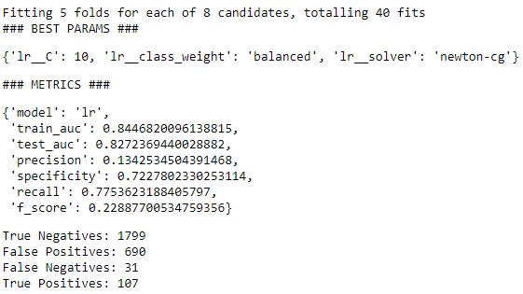
Final Model Selected: Logistic Regression (no SMOTE)
Notes:
Show Params used: Put final parameters + metrics for logreg (right side)
Explain how imbalance data was accounted for through class weights

Slide 24
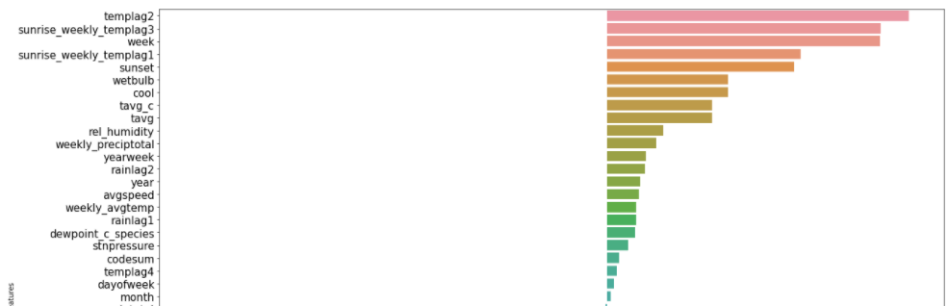
Top Features
Strong predictors are related to temp lag and temperature features
Corroborates our earlier findings

Slide 25
At what cost?

Slide 26
Cost of Spraying
Medical Costs
Sprayer trucks using Zenivex E4
Spray duration of 5 hours
$844 - $1688 per truck
Total area of Chicago
606.1km2
Total cost of spraying
$844k - $1.69mil
Inpatient & Outpatient costs
≈ $33k per inpatient WNV case
≈ $6k per outpatient WNV case
≈ $18k per WNV patient (nursing home)
Productivity costs
≈ $11k per patient < 60 years old
≈ $8k per patient > 60 years old
Total cost
Medical + productivity loss
≈ $3.7mil
Notes:
The cost of Zenivex E4 is about $80 per gallon (North Dakota Department of Health, 2013). Given the current rate of spraying and assuming a total spray duration of 5 hours, the cost of pesticides for each sprayer truck is $843.76 - $1687.50. Given that the total area of Chicago is 606.1 km2, it would take about 1000 trucks at the same time to cover the entire area. This brings the cost of spraying to be around $843,760 - $1,687,500.
A rough estimate puts cost per WNV case at ≈$33,143 per inpatient and ≈$6,317 per outpatient for all treatments. Cost for each WNND patient estimated to have spent time in a nursing home was ≈$18,097. Productivity loss during symptomatic WNND cost $10,800 per patient <60 years of age and $7,500 per patient >60 years of age (Table 3). Total medical costs accrued by all WNND patients was ≈$2,791,838; total costs for all cases (medical cost plus productivity loss) was ≈$3,710,006. (Barber LM, Schleier JJ 3rd, Peterson RK, 2010)

Slide 27
73%*
Number of cases before spray program (2002)
225 cases
22 fatalities
Number of cases after spray program (2012)
60 cases
4 fatalities
* Based on rough estimates of cases in 2002 vs 2012
https://www.chicago.gov/content/dam/city/depts/cdph/statistics_and_reports/CDInfo_2013_JULY_WNV.pdf
Notes:
As you can see, the effects of spraying does work
With up to an estimated of 73% decrease in WNV cases after the spraying program started
Evidence that spraying works
Spraying might be more cost-efficient as compared to increase in medical bills and productivity loss
Next we will explore in-depth the efficacy of spraying from past data, and analyse how to efficiently manage cost-benefit of spraying
https://www.chicago.gov/content/dam/city/depts/cdph/statistics_and_reports/CDInfo_2013_JULY_WNV.pdf

Slide 28
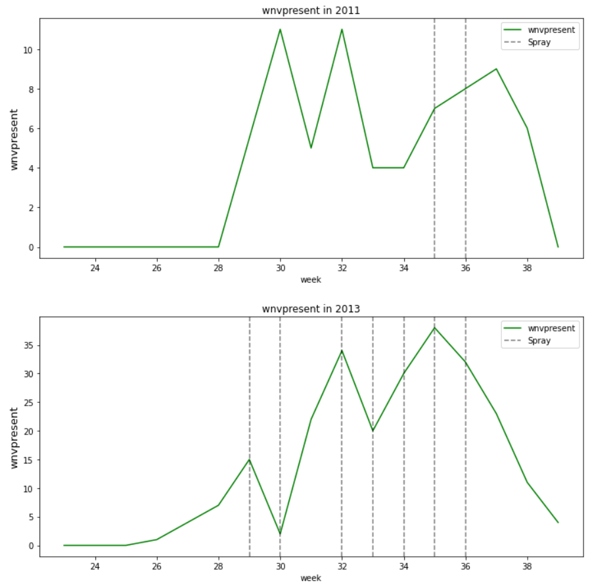
Cost Benefit Analysis:
Spray Efficacy
2013:
Sprayings almost every week (week 29 to 36, from 17 July 2013 to 5 Sept 2013)
WNV occurrences peak (weeks 29, 32, 35)
Spraying done with reduction in WNV on next immediate weeks (weeks 30, 33, 36 and beyond)
Although WNV increased again subsequently in-between the weeks aforementioned, pattern shows spraying curbs WNV
Notes:
First, let’s take a look at spray efficacy of past data
Is it the most cost efficient? Not really. For existing data.
Why does the data not show a clear pattern? Aka why is it not so cost efficient?
A slight pattern can be seen where spraying curbs WNV cases for the year 2013
We need to investigate why spraying didn’t give us a clear pattern of decrease in WNV
We will take a look at the locations that were sprayed

Slide 29
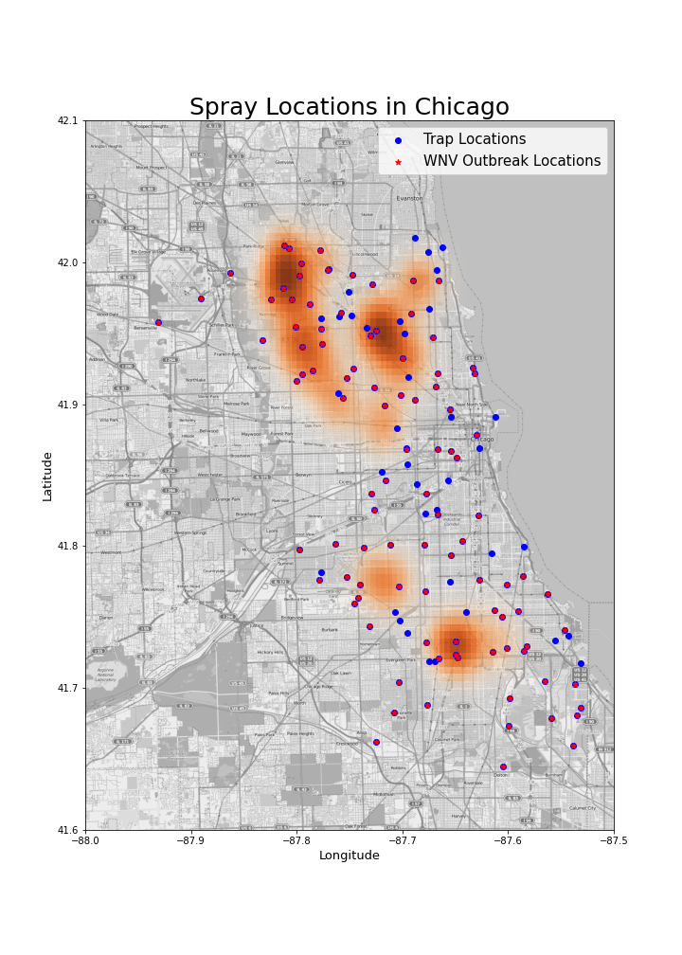
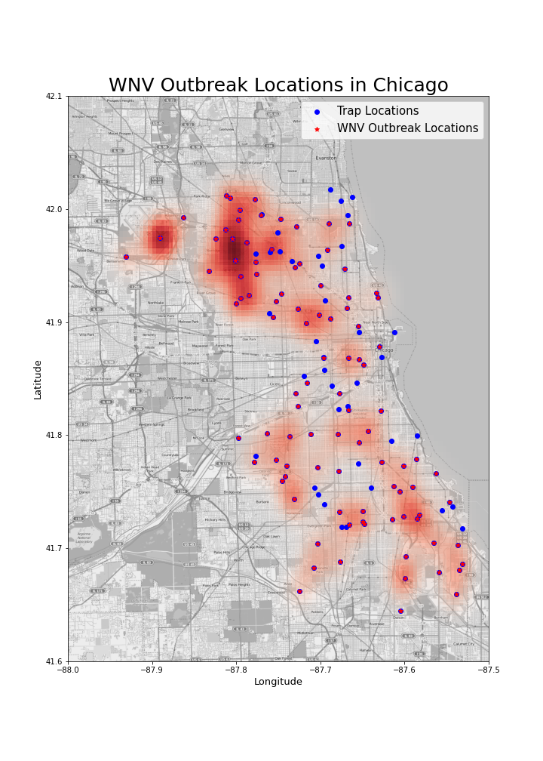
Cost Benefit Analysis:
Spray and WNV Locations
Accurate spraying locations on WNV locations:
North-West from city (-87.65 , 41.95)
Further North-West (-87.8 , 41.9 to 42)
South, small spot (-87.65 , 41.7)
WNV locations inadequately or not covered by spraying:
Furthest North-West (-87.9 , 42)
South of city, huge scattered area (-87.5 to -87.8 , 41.6 to 41.8)
South -West small spot inadequately/inaccurately covered (-87.7 , 41.8)
Notes:
After more analysis, we realised it is not the most cost efficient, because some areas were inadequately sprayed.
Spraying helps, just that for existing data, some areas are not sprayed enough.
Effects of spraying can be seen, but can also be improved
Improved by better spraying accuracy to locations with WNV
To conclude CBA:
From our cost-benefit analysis, we have concluded that:
Spraying definitely helps
It is cheaper to increase sprays and prevent WNV cases, as compared to increasing medical costs due to WNV patients and productivity losses from incapacitated workers
Past dataset shows that spraying accuracy needs to be improved
As such, to increase cost-benefit of spraying, we recommend better spraying accuracy.

Slide 30
Recommendations

Slide 31
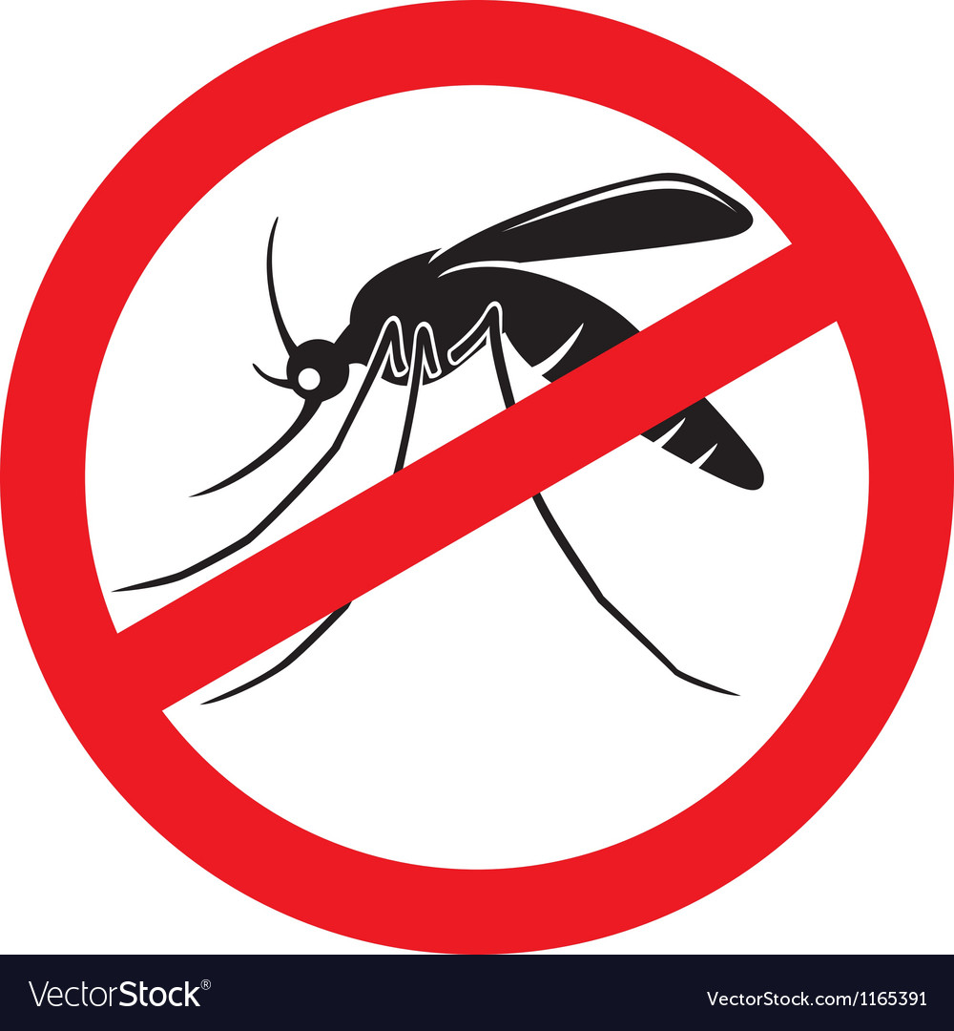
Recommendations
From cost benefit analysis
Increase sprays to cover more WNV occurrence areas
Reduce inaccurate sprayings
Increase accurate sprays with the aid of prediction model and visualisation
Increase sprays
Increase spray spendage
Decrease WNV cases
Decrease medical costs
Decrease overall costs
Notes:
From our cost-benefit analysis, we have concluded that:
Spraying definitely helps
It is cheaper to increase sprays and prevent WNV cases, as compared to increasing medical costs due to WNV patients and productivity losses from incapacitated workers
Past dataset shows that spraying accuracy needs to be improved
Recommendation: Spray more accurately at locations with WNV

Slide 32
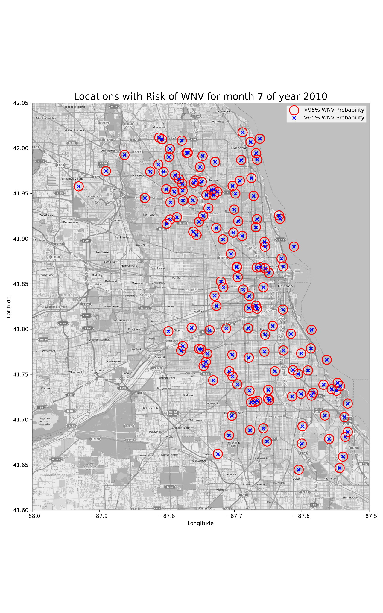
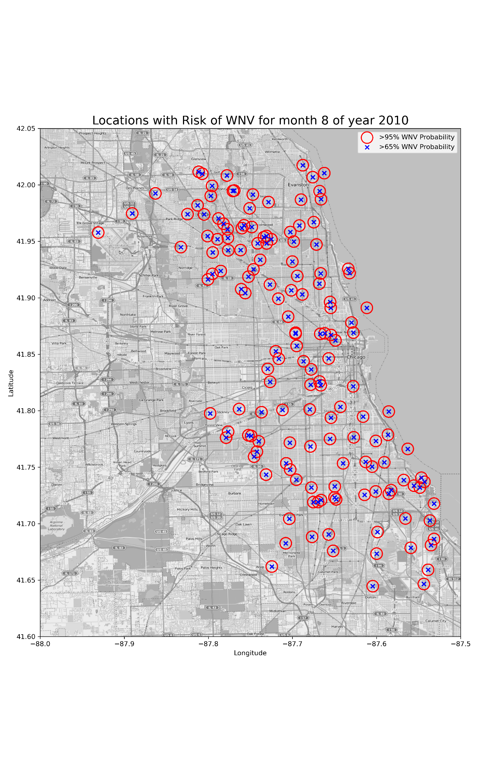
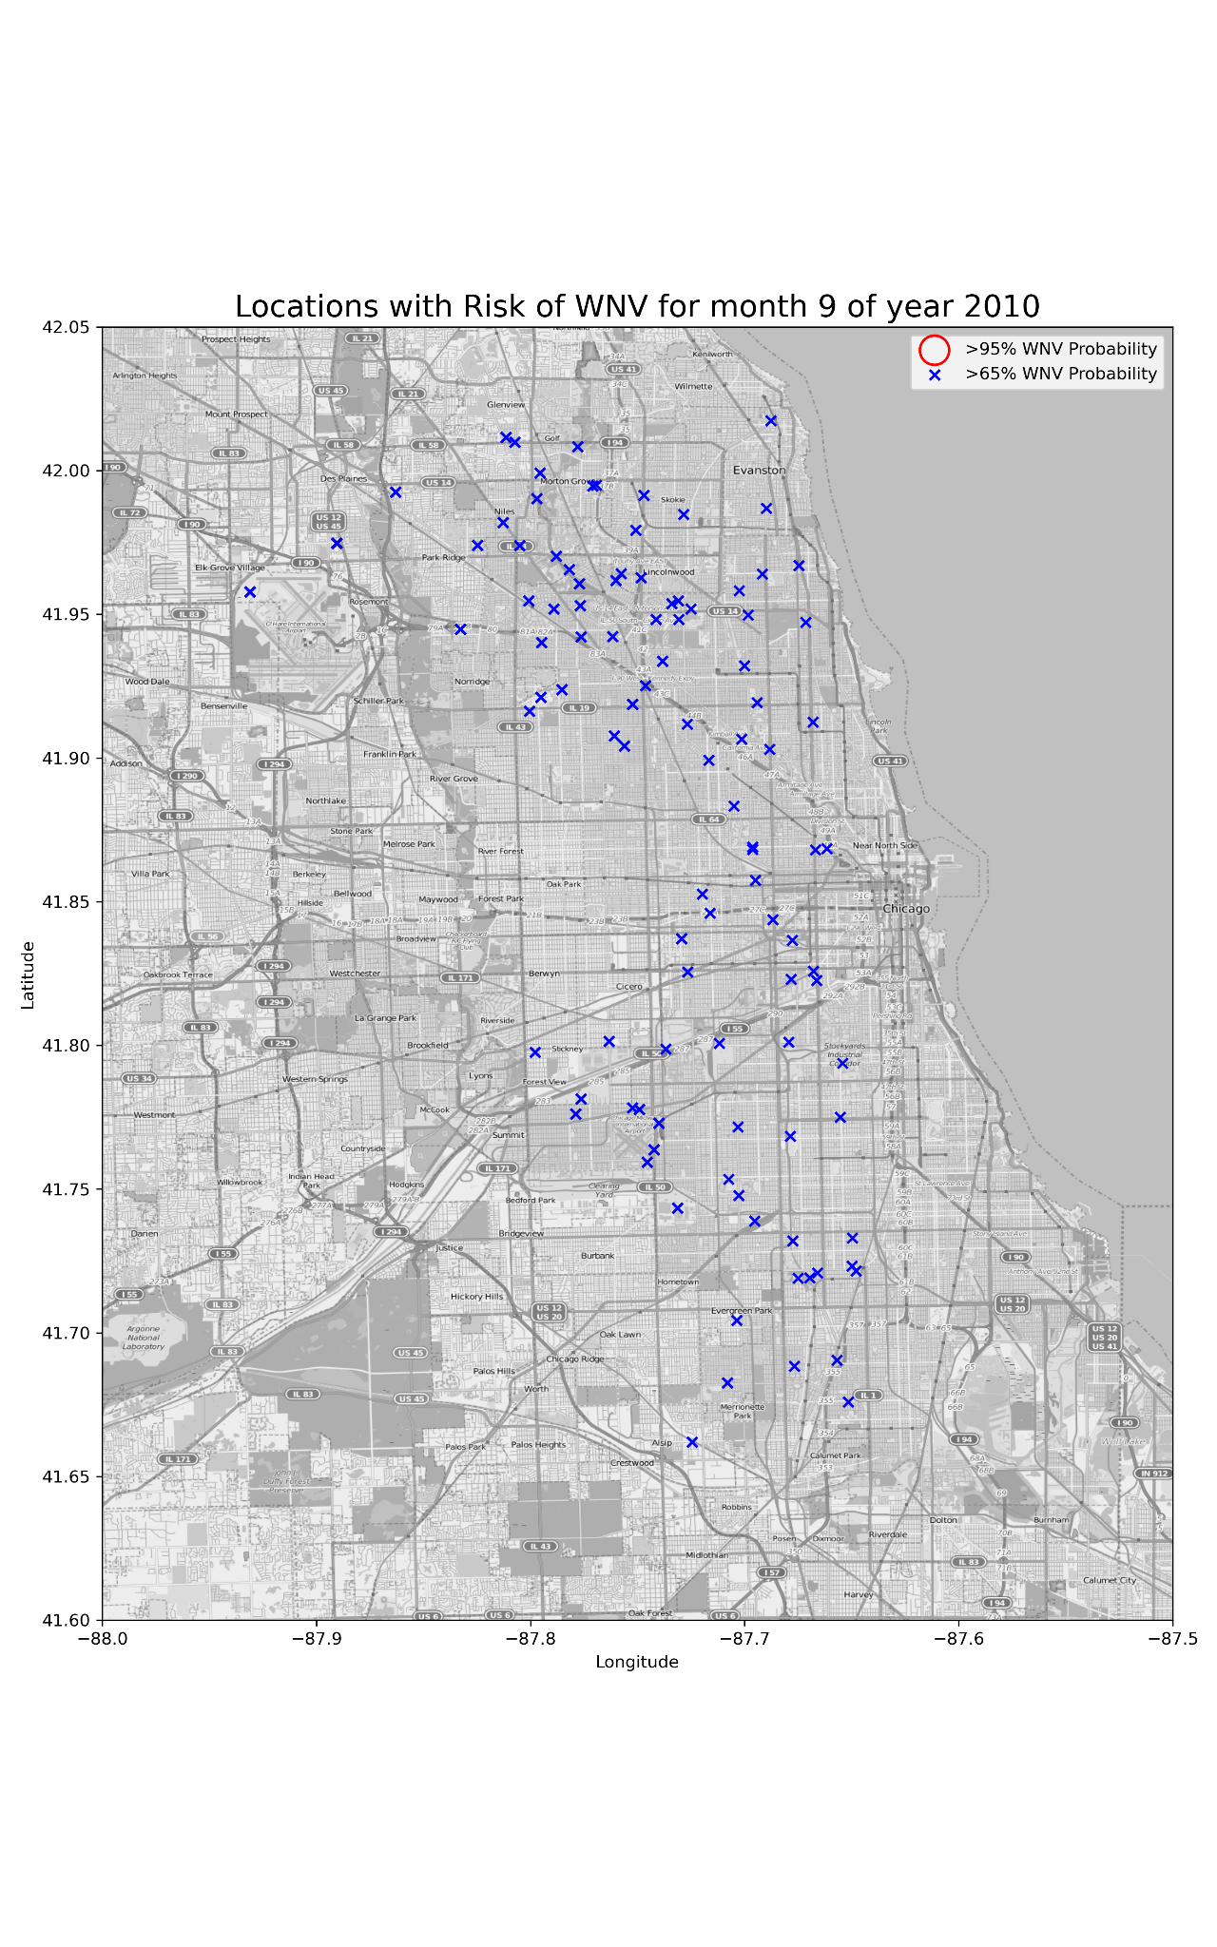
Recommendations: Where to spray? Year 2010
Notes:
Using our production model, we attempted to predict potential WNV outbreak locations. We plotted areas with two different probabilities of WNV presence. The first being a 95% probability which is indicative that the area plotted has a very high probability of the WNV outbreak happening. We also plotted areas with 65% probability which indicates that the area has an above average probability of a WNV outbreak happening. This was plotted over 3 months and repeated for 2 years.
We first plotted the maps for year 2010 in the Summer months July and August as well as 1 month after in September
In year 2010, we can see that there were critically high probability of WNV occurrences in numerous areas, for both months.
However in September, we can see that the number of locations with critically high probability of WNV occurrence drops drastically.
From our cost-benefit analysis, we have concluded that:
Spraying definitely helps
It is cheaper to increase sprays and prevent WNV cases, as compared to increasing medical costs due to WNV patients and productivity losses from incapacitated workers
Past dataset shows that spraying accuracy needs to be improved
Recommendation: Spray more accurately at locations with WNV

Slide 33
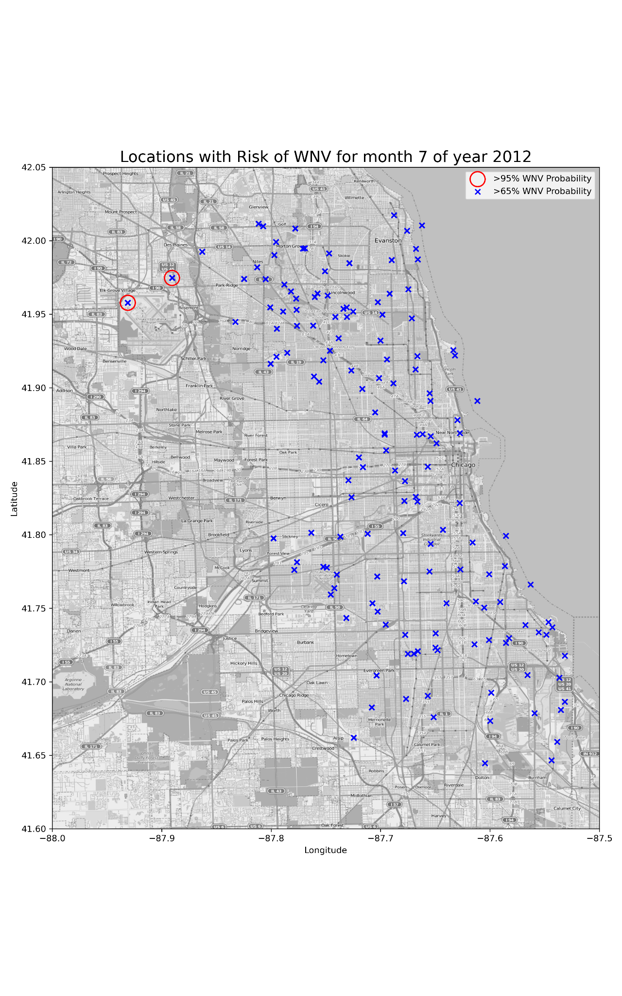
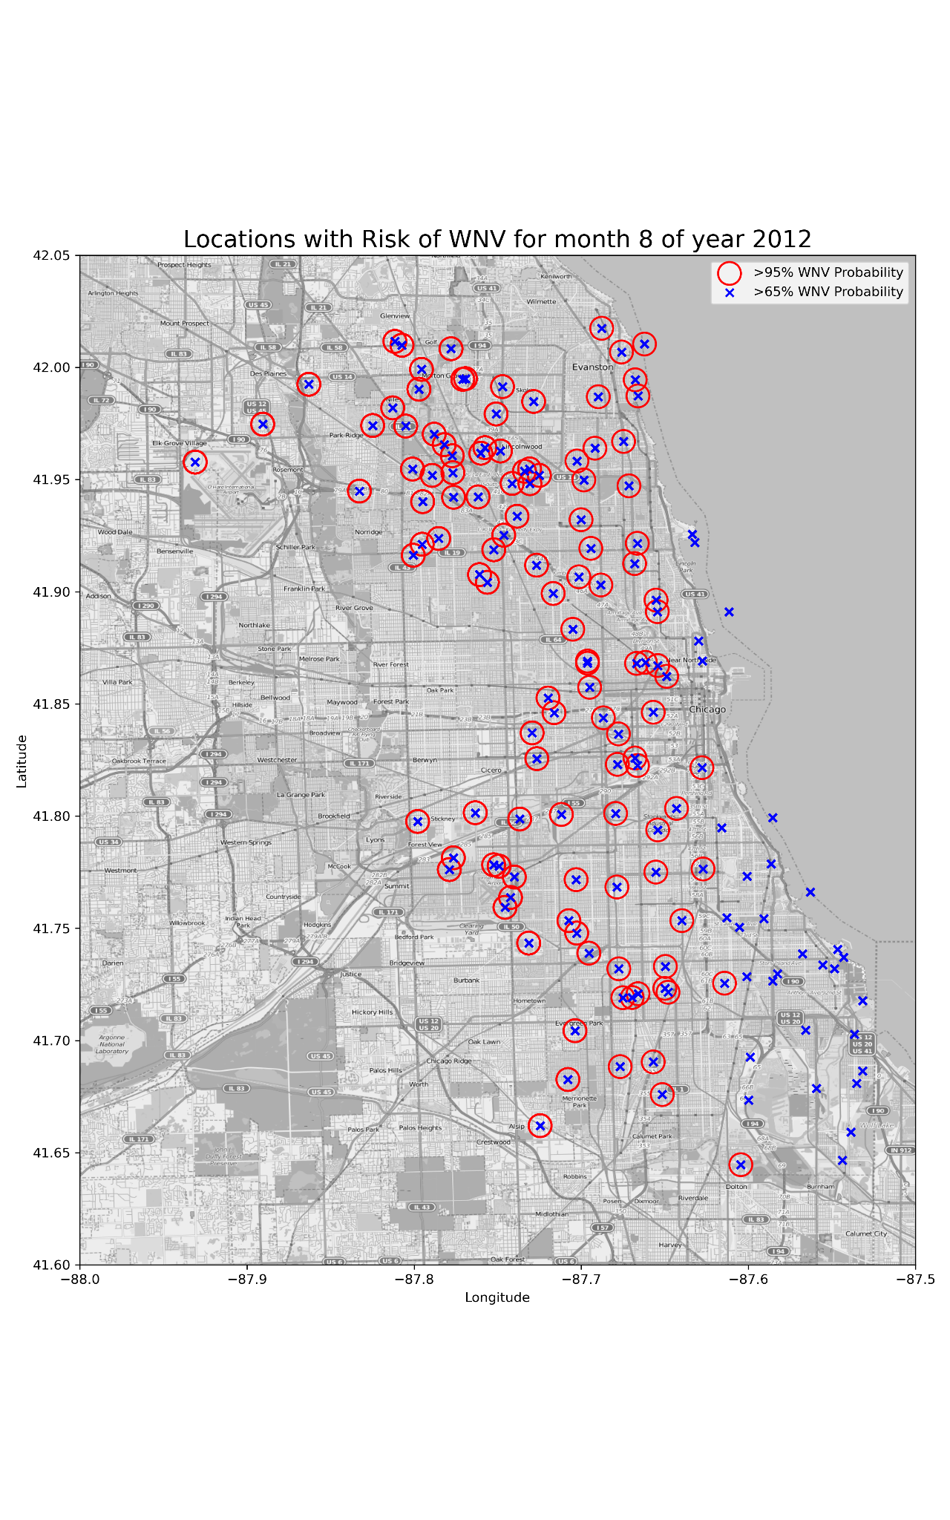
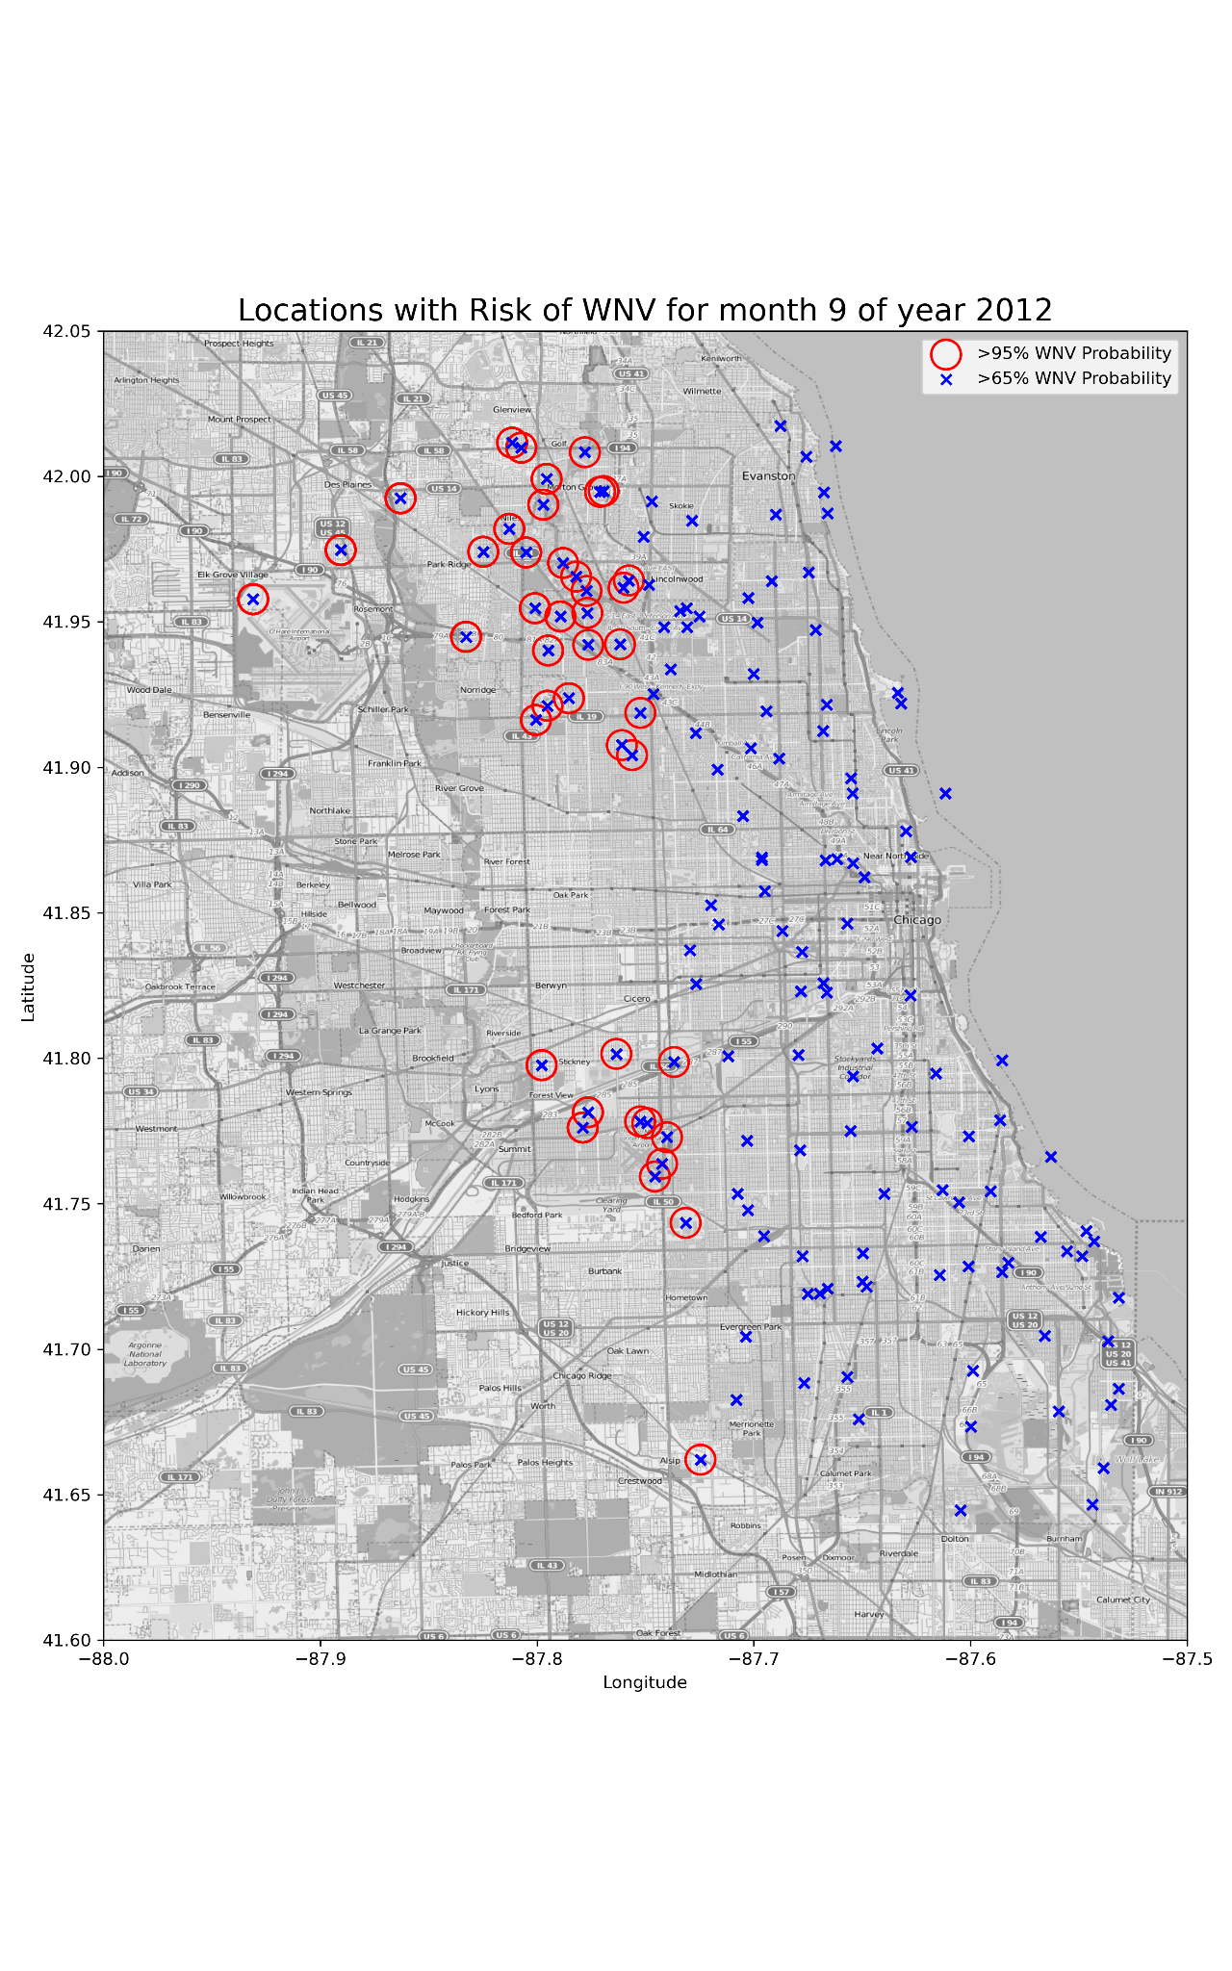
Recommendations: Where to spray? Year 2012
Notes:
We then plotted the maps for year 2012 also in the Summer months July and August as well as 1 month after in September
In year 2012, we can see that there were also critically high probability of WNV occurrences in numerous areas but this was only predicted to occur in August.
However in September, we can see that the number of locations with critically high probability of WNV occurrence drops albeit not as drastically as the year 2010. Using this, we can then use our production model to predict which areas are potential areas with critically high probability which are then areas to be targeted for spraying.
From our cost-benefit analysis, we have concluded that:
Spraying definitely helps
It is cheaper to increase sprays and prevent WNV cases, as compared to increasing medical costs due to WNV patients and productivity losses from incapacitated workers
Past dataset shows that spraying accuracy needs to be improved
Recommendation: Spray more accurately at locations with WNV

Slide 34

Model Limitations
Geographical limitations:
Limited to only the city of Chicago
Dataset limitations:
More years of data
Consecutive years of data
Spray dataset limitations
Notes:
Geographical limitations.
Limited to only city of Chicago
Dataset that this model was trained on was only from this city. This means that we will not be able to get accurate results if this model were to be used anywhere else.
Dataset limitations:
More years of data
We only had 4 years of data
Instead of alternate years, if we get consecutive years of data, might get a more accurate model
Just like for weather dataset, which had very substantial data, if we were to get many more years from 2007 to 2014, that’d be great
Spray dataset limitations. Too little years to make sense of an obvious pattern.
Only 2 years of data
Hindered our analysis to derive a pattern to show the effectiveness of the sprays
Luckily additional research was able to back our stand on increasing spraying

Slide 35
Thank you!

